Slide 1
Numerical solution of SIR model for transmission of tuberculosis by Runge-Kutta method
Me 601
Vivek kumawat (11941380)
Vipeen kumar (11941360)

Slide 2
Problem Statement
Tuberculosis is one of the oldest observed human afflictions. It is still one of the primary causes of mortality among infectious diseases since two million people die each year from this sickness. Tuberculosis has many indications, affecting bone, the central nervous system, and many other vital organ systems.
It is primarily a pulmonary disease initiated by the deposition of Mycobacterium tuberculosis. It is mainly spread through the air from an infected person to a healthy person. When an infected person sneezes or speaks, the bacteria get into the air. People nearby may take a breath, and these bacteria, along with air, went through its respiratory system.
For predicting the future condition that will be made by the pandemic, we have a model that helps to do this.

Slide 3
Aim
The main aim is to find the numerical solution of the SIR model on the spread of tuberculosis infection in a particular region. For the result and solutions of this problem statement, we will be using the fourth-order Runge-Kutta method.
The objective is to develop a theoretical and mathematical model of the Runge-Kutta method and solve the resulting system of differential equations numerically on a computer. From the result analysis of the model using data, we will be viewing the trend of increase or decrease in the tuberculosis cases in Makassar (a port city on eastern Indonesia’s Sulawesi Island), a highly affected area by tuberculosis cases. Here, we will be taking some older data on tuberculosis in some regions for the study and analysis.

Slide 4
SIR Model for Transmission of Tuberculosis
The SIR model is a mathematical model that predicts what is the rate of spread epidemic, how bad is the epidemic going to be in the future. These models attempt to forecast things like how a disease spreads, the total number of people infected, and the length of an outbreak, as well as estimate epidemiological parameters like the reproductive number. These models may show how various public health interventions can influence the epidemic's outcome.
In this model, we divide all the peoples of a particular region or city into three categories, the first category is called Susceptibles. They are the peoples that are capable of becoming sick from an infection (an infection that is capable of infecting everybody).
The second category of people is called Infectious, they are those who got infected from infections. They were initially in the first category (susceptibles) and after getting infected they come to the second category.
The third category is called Recovered, they are those who got recovered from the infections after being cured. We assume the death rate to be very less ( negligible) compared to that of other categories. So, this results in the fact that the sum of all three categories of peoples; Susceptibles, Infectious, and Recovered are the total number of peoples (everybody) of that region that is the whole population.

Slide 5
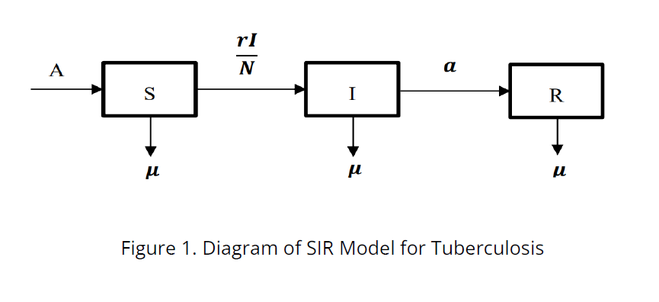
Now we take any particular time to see what happened to these values at that time, which we
call the initial condition or T=0. There are two possibilities for the initial conditions; one is that
we took the initial conditions at the time when the epidemic is going on. At that time mostly
none of the conditions were zero. Another possibility is that we chose the initial conditions at
the time when there were no recovered people in that region or town. So, at the time the
initial value R(0) = 0, i.e. the number of recovered people is zero.

Slide 6
Governing SIR Equations
ASSUMPTIONS:
● An infected person need not be infectious all time; it can be infectious for a time period of 𝑇0 with minimal deviation from its mean value 𝐸(𝑇 . 0)
● The time that an infected person takes to become infectious is much shorter than that of its mean value 𝐸(𝑇 ; which we neglected in calculations. 0)
● After passing the Infectious stage, it is hard to get infected again until a period 𝑇 , because of 1 an increase in their immune system while curing from the infection. It satisfied 𝐸(𝑇 . Here, p is a positive integer. 1) ≈ 𝑝𝐸(𝑇0)
● When the infected person during Infectious meets the susceptible person, there is a possibility that others get affected with the probability of q.

Slide 7
Governing SIR Equations
Base on different assumptions mentioned above and relations between all these categories of the SIR model; we get the following equations
𝑑𝑆/𝑑𝑡 = 𝐴 − ⲙ𝑆 − 𝑟𝐼 S/N
𝑑𝐼/𝑑𝑡 = 𝑟𝐼 S/𝑁 − (ⲙ + 𝑎)𝐼
𝑑𝑅/𝑑𝑡 = 𝑎𝐼 − ⲙ𝑅
Here,
𝑁 = 𝑆 + 𝐼 + 𝑅
t = time
S = Number of vulnerable individuals in the population at time t
I = Number of infected individuals in the population at time t
R = Number of individuals who recover in the population at time t
r = The rate of transmission of the disease (0 ≤ 𝑟 ≤ 1)
a = The rate of recovery from infectious to recovered
A = Initial value
Ⲙ = Death rate

Slide 8
We will take a general first-order differential equation which is given by the expression:
𝑑𝑦/𝑑𝑥 + 𝑃(𝑥) * 𝑦 = 𝑄(𝑥)
where
𝑑𝑦/𝑑𝑥 is derivative,
𝑃(𝑥) and 𝑄(𝑥)are continuous functions of x.
We solve this linear differential equation of first order by using integrating factors.
𝐼. 𝐹 = 𝑒xp(∫𝑃(𝑥) 𝑑𝑥) (Integrating Factor )
then after solving we get a general solution as:
𝑦 = (1/𝑒xp(∫𝑃𝑑𝑥)) (∫ 𝑄 * (𝑒xp (∫𝑃𝑑𝑥))𝑑𝑥 + 𝑐
The solution of the linear differential equation produces the value of variable y. We find the final value of y from the above three mentioned methods and compare the results and finally, we will find the best method to choose for solving ODE.
Here, we considered a simple equation as an example:
𝑑𝑦/𝑑𝑥 = 𝑓(𝑥, 𝑦)
where , 𝑓(𝑥, 𝑦) = 3𝑒−𝑥 − 0. 4𝑦 with Initial Conditions: 𝑦(𝑥 = 0) = 5

Slide 9
Analytical Method
Error Analysis of Euler Method:
𝑦𝑖+1 = 𝑦(𝑥𝑖 +1) = 𝑦(𝑥𝑖 + ℎ)
Using the Taylor series expansion method,
𝑦𝑖+1 = 𝑦(𝑥𝑖 ) + ℎ 𝑓(𝑥𝑖 , 𝑦𝑖) + ℎ^2/2! (𝑑𝑓(𝑥𝑖 , 𝑦𝑖)/𝑑𝑥) + ℎ^2/3! (𝑑^2𝑓(𝑥𝑖 , 𝑦𝑖)/𝑑𝑥^2) + ......
𝑦𝑖+1 = 𝑦𝑖 + ℎ 𝑓(𝑥𝑖 , 𝑦𝑖) + ℎ^2/2!(𝑑𝑓(𝑥𝑖 , 𝑦𝑖)/𝑑𝑥) + 𝑂(ℎ^3) + ....
So error for the Euler method is of Order: ℎ^2 ( Local truncation Error ).
Global truncation Error: 𝑂(ℎ )

Slide 10
Fourth-Order Runge-Kutta Method
The equations that are used to solve differential equations using Fourth Order Runge-Kutta Method:
𝑦(𝑟+1) = 𝑦(𝑟) + (ℎ/6) (𝑘(1) + 2𝑘(2) + 2𝑘(3) + 𝑘(4))
where,
𝑘(1) = 𝑓(𝑥(𝑟) , 𝑦(𝑟))
𝑘2 = 𝑓(𝑥(𝑟) + (½) ℎ, 𝑦(𝑟) + (½) 𝑘(1) ℎ)
𝑘3 = 𝑓(𝑥(𝑟) + (½) ℎ, 𝑦(𝑟) + (½) 𝑘(2) ℎ)
𝑘4 = 𝑓(𝑥(𝑟) + ℎ, 𝑦(𝑟) + 𝑘(3) ℎ)
Now we will code in MatLab and get the answer. We get, ( please find the attached codes
below )

Slide 11
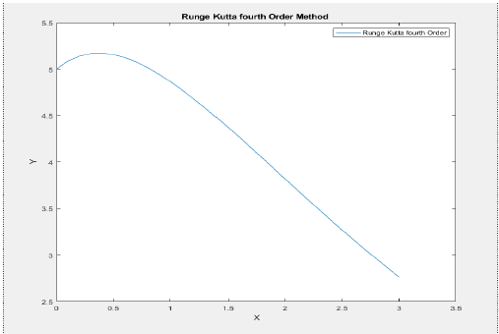
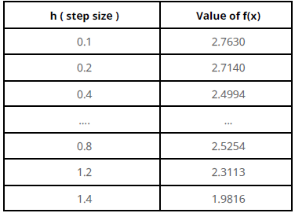
When we change the value of h, we will also see a change in the values from the exact value
and the graph also changes.
So, now we can do the error analysis part in the same as above
We get, Local truncation Error: 𝑂(ℎ^5 )
Global truncation Error: 𝑂(ℎ^4 )

Slide 12
➢ Exact value: 2.763006777
➢ Euler method value: 2.7630
➢ ε𝑡 = 𝑇𝑟𝑢𝑒 𝑣𝑎𝑙𝑢𝑒 − 𝐴𝑝𝑝𝑟𝑜𝑥𝑖𝑚𝑎𝑡𝑒 𝑣𝑎𝑙𝑢𝑒
𝑇𝑟𝑢𝑒 𝑣𝑎𝑙𝑢𝑒 = 2.763006777 − 2.7630
2.763006777 = 2. 452762714 * 10−6
➢ % ε𝑡 = 2. 452762714 * 10−4

Slide 13
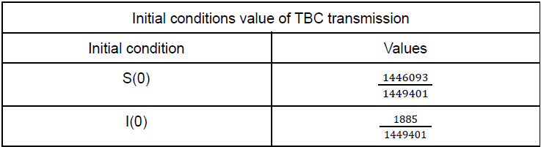
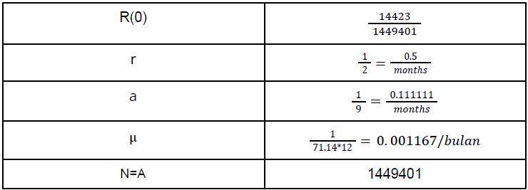
Boundary Conditions and Parameters ( Source )
To solve the differential equations we need to found parameters and boundary conditions which is given in these equations:-
Table 1

Slide 14
Solving SIR Model using Fourth-order Runge-Kutta method
Here we are solving three ODEs
⇒ 𝑑𝑆/𝑑𝑡 = 𝑓1(𝑡, 𝑆, 𝐼, 𝑅) = 𝐴 − ⲙ𝑆 − 𝑟𝐼 S/𝑁
⇒ 𝑑𝐼/𝑑𝑡 = 𝑓2(𝑡, 𝑆, 𝐼, 𝑅) = 𝑟𝐼 S/𝑁 − (ⲙ + 𝑎)𝐼
⇒ 𝑑𝑅/𝑑𝑡 = 𝑓3(𝑡, 𝑆, 𝐼, 𝑅) = 𝑎𝐼 − ⲙ𝑅
Here, Equations (i), (ii) and (iii) are functions to solve,
𝑁 = 𝑆 + 𝐼 + 𝑅
ⲙ, r and 𝑎 are experimental(controlling) parameters.
If R(0)>1 then it will be an epidemic stage.

Slide 15
The solution for the above system of coupled nonlinear ordinary differential equations is given by:
𝑆(𝑟 + 1) = 𝑆(𝑟) + (ℎ/6) (𝑘1 + 2𝑘2 + 2𝑘3 + 𝑘4)
𝐼(𝑟+1) = 𝐼(𝑟) + (ℎ/6) (𝑙1 + 2𝑙2 + 2𝑙3 + 𝑙4)
𝑅(𝑟+1) = 𝑅(𝑟) + (ℎ/6) (𝑚1 + 2𝑚2 + 2𝑚3 + 𝑚4)
where, h = step size ( difference between two variable values)
𝑘1 = 𝐴 − ⲙ 𝑆(𝑟) − (𝑟/𝑁) 𝐼(𝑟) 𝑆(𝑟)
𝑘2 = 𝐴 − ⲙ(𝑆(𝑟) + 𝑘1 (ℎ/2)) − (𝑟/𝑁) (𝐼(𝑟) + 𝑙(1) (ℎ/2) )* (𝑆(𝑟) + (ℎ/2) 𝑘1)
𝑘3 = 𝐴 − ⲙ(𝑆(𝑟) + 𝑘2 (ℎ/2)) − (𝑟/𝑁) (𝐼(𝑟) + 𝑙(2) (ℎ/2) ) *(𝑆(𝑟) + (ℎ/2) 𝑘2)
𝑘4 = 𝐴 − ⲙ(𝑆(𝑟) + 𝑘3 (ℎ)) − (𝑟/𝑁) (𝐼(𝑟) + 𝑙(3) ℎ)*(𝑆(𝑟) + ℎ 𝑘3)
𝑙1 = (𝑟/𝑁) 𝐼(𝑟) 𝑆(𝑟) − (ⲙ + 𝑎)𝐼(𝑟)
𝑙2 = (𝑟/𝑁) (𝐼(𝑟) + 𝑙1 (ℎ/2)) (𝑆(𝑟) + 𝑘1 (ℎ/2)) − (ⲙ + 𝑎)(𝐼(𝑟) + (ℎ/2) 𝑙1)
𝑙3 = (𝑟/𝑁) (𝐼(𝑟) + 𝑙2 (ℎ/2)) (𝑆(𝑟) + 𝑘2 (ℎ/2)) − (ⲙ + 𝑎)(𝐼(𝑟) + (ℎ/2) 𝑙2)
𝑙4 = (𝑟/𝑁) (𝐼(𝑟) + 𝑙3 ℎ) (𝑆(𝑟) + 𝑘3 ℎ) − (ⲙ + 𝑎)(𝐼(𝑟) + 𝑙3 ℎ)

Slide 16
𝑚1 = 𝑎 𝐼(𝑟) − ⲙ 𝑅(𝑟)
𝑚2 = 𝑎 (𝐼(𝑟) + 𝑙1 (ℎ/2)) − ⲙ(𝑅(𝑟) + (ℎ/2) 𝑚1 )
𝑚3 = 𝑎 (𝐼(𝑟) + 𝑙2 (ℎ/2)) − ⲙ(𝑅(𝑟) + (ℎ/2) 𝑚2 )
𝑚4 = 𝑎(𝐼(𝑟) + 𝑙3 ℎ) − ⲙ(𝑅(𝑟) + ℎ 𝑚3 )
After putting the values of parameters in the above equation and completing the equations. So we have to solve three sets of constants (𝑘1 ,k2 ,k3 ,k4) (l1 ,l2 ,l3 ,l4 ), (m1,m2 ,m3 ,m4 ) for the functions respectively:
𝑑𝑆/𝑑𝑡 = 1449401 − 0. 001167 𝑆 − (0.5 𝐼 /1449401) 𝑆
𝑑𝐼/𝑑𝑡 = (0.5 𝐼 / 1449401) 𝑆 − (0. 001167 + 0. 111111) * 𝐼
𝑑𝑅/𝑑𝑡 = 0. 111111 𝐼 − 0. 001167 𝑅

Slide 17
Results
The results that we got in the form of graphs using the MatLab simulation are given in the below images using time interval per month, time step, and initial condition in the form of parameter value and initial value as in Table 1.
The below image (figure 1), shows how the changes in the susceptible rate should happen in the next few months. As seen from it, a linear increase in the number of susceptible populations happens at the start. As from our data, the initial value of the susceptible population was 1446093 out of the total population ( which is 1449401). The increment is because the measure of the populace or the underlying worth utilized is more noteworthy than the measure of populace decrease in the associated class in the structure with sickness transmission rate from suspected to irresistible and the demise pace of the speculated class. After reaching a peak value, the susceptible population suddenly decreased and continued to remain the same, which indicates that we may find few susceptible people later, but in the future, there will be no further increase in it.

Slide 18
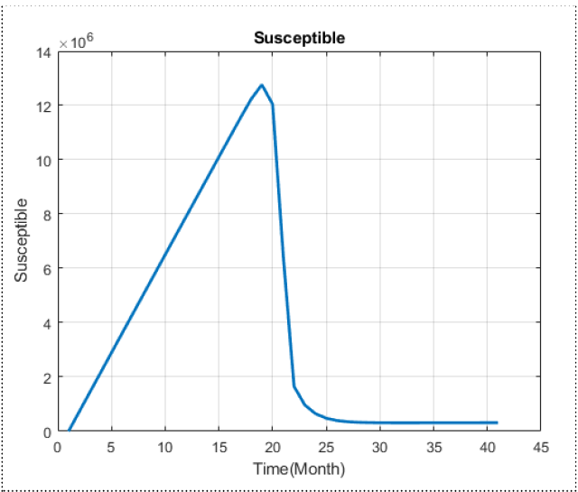

Slide 19
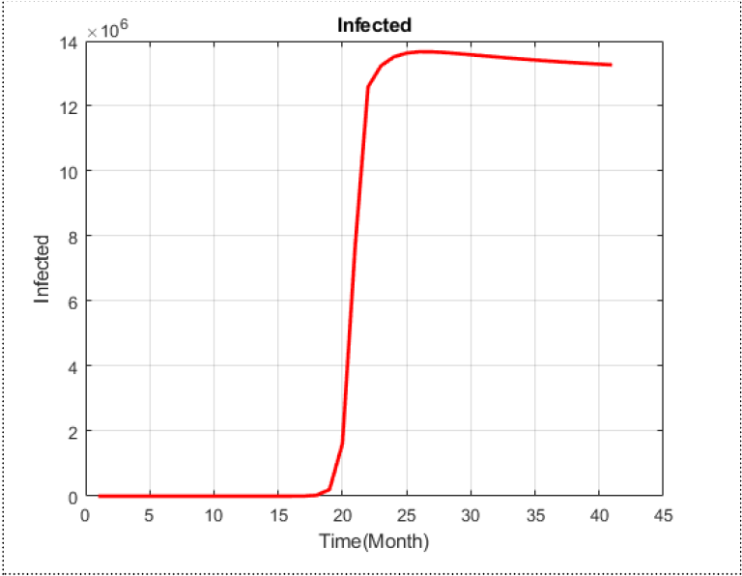
As per data, there were only 1885 people infected with Tuberculosis at the start out of the 1449401 population. The simulation result ( figure 2) shows that after a few time periods, we will see a huge increase in the number of infected people. This happens because of the fact that in those time periods the rate of people getting infected is greater than that of the rate of people getting recovered from infections. The graph also shows that after getting affected it takes much time to get recovered as it shows a slight inclination in it.

Slide 20
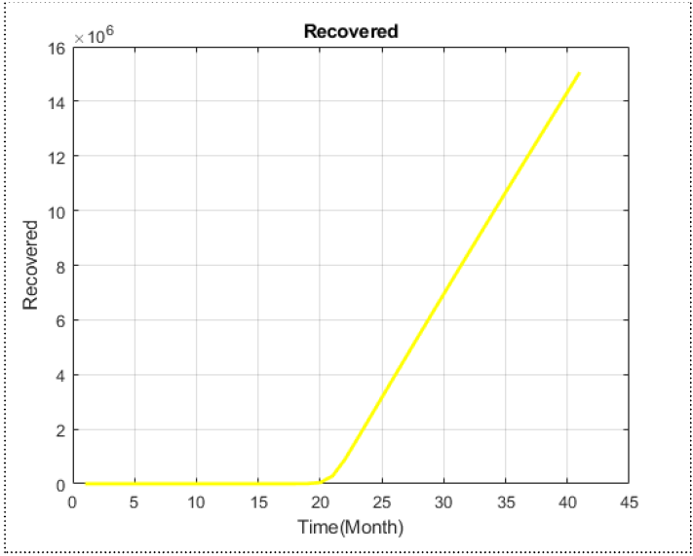
According to Figure 3, there seems to be no rise in the amount recovered until a time-lapse of 21 months. According to our records, 1423 people were recovered out of a total of 1449401 at the start. There appears to be a linear rise in the number of recovered populations after around 21 months. The recovery rate was initially negligible because it depends on the speed of transmission of people from infected to recovered. As shown in figure (2), the infected graph begins to rise sharply after 21 months, and the recovery graph follows suit.

Slide 21
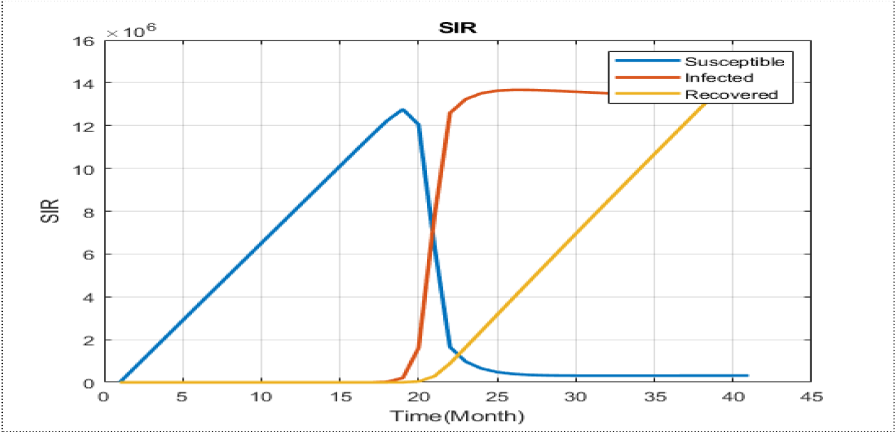
According to figure 4, which shows all the different rates with time, there is an increase in the number of susceptible people until around the 21th month. Then, a sudden increase in the number of infected people is observed. Till that time, the recovery rate seems negligible. However, once the infection goes to its peak, the rate of recovery starts increasing with a decrease in the infected rate. And the recovery continued rising over time. Here, recovery may have done through many different factors.

Slide 22
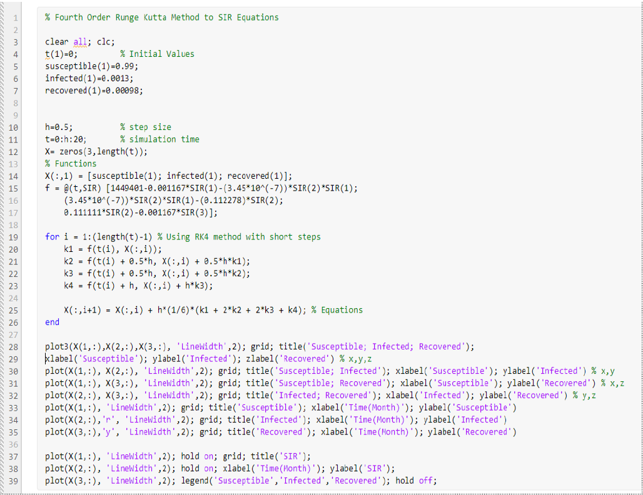
Matlab code

Slide 23
Thank you

